Slide 1
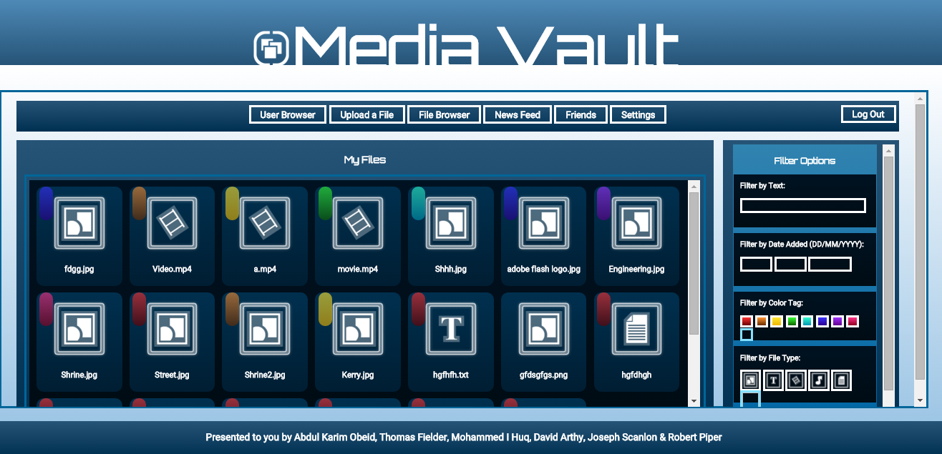
Deleting Kerry.jpg (Testing Admin Delete)

Slide 2
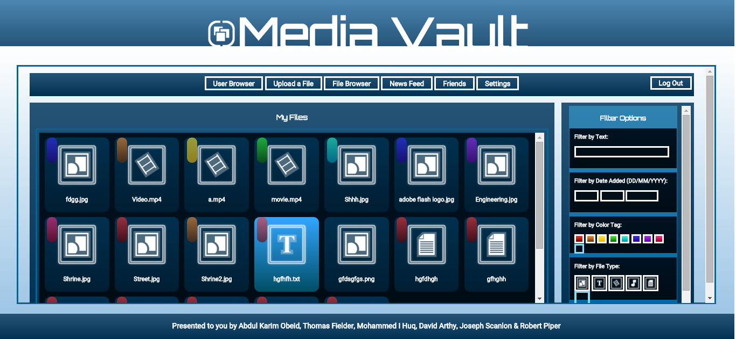
Kerry.jpg Deleted. (Success!)

Slide 3
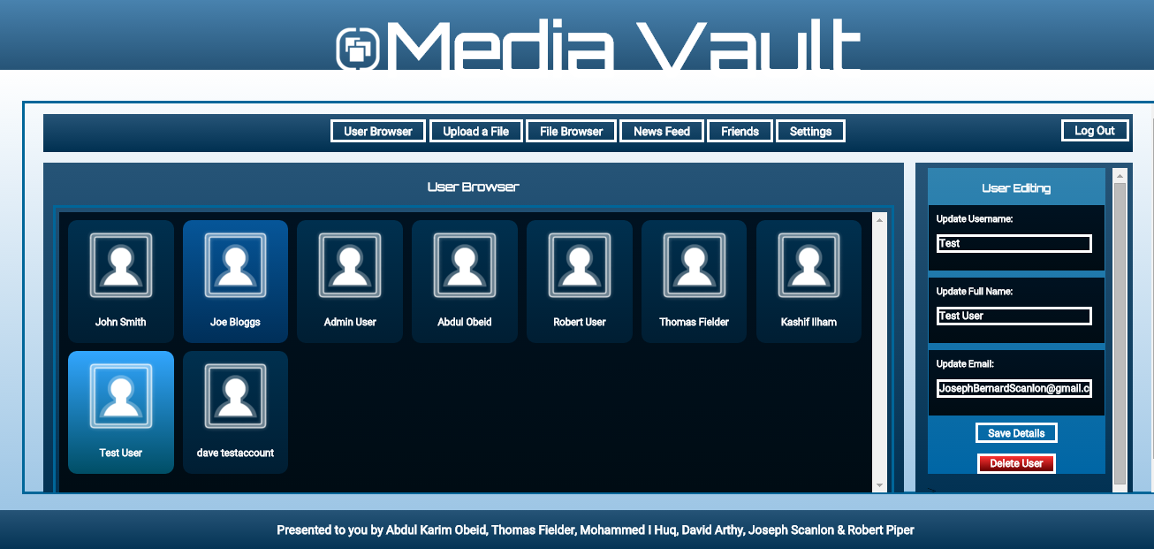
Editing Test User Full Name (Testing Admin Editing)

Slide 4
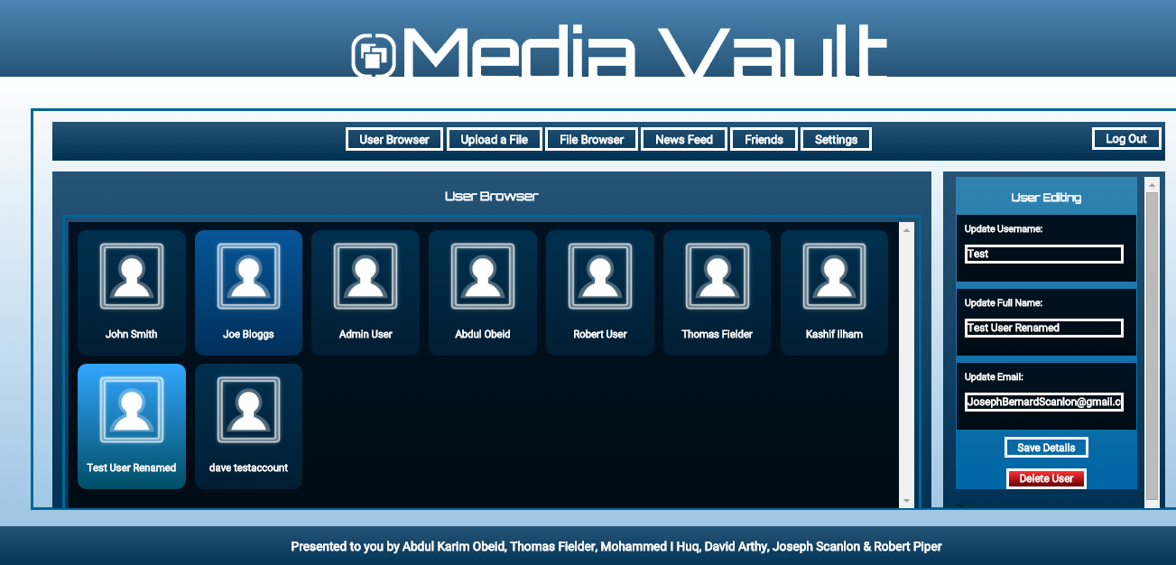
Test User Full Name Changed (Success!)

Slide 5
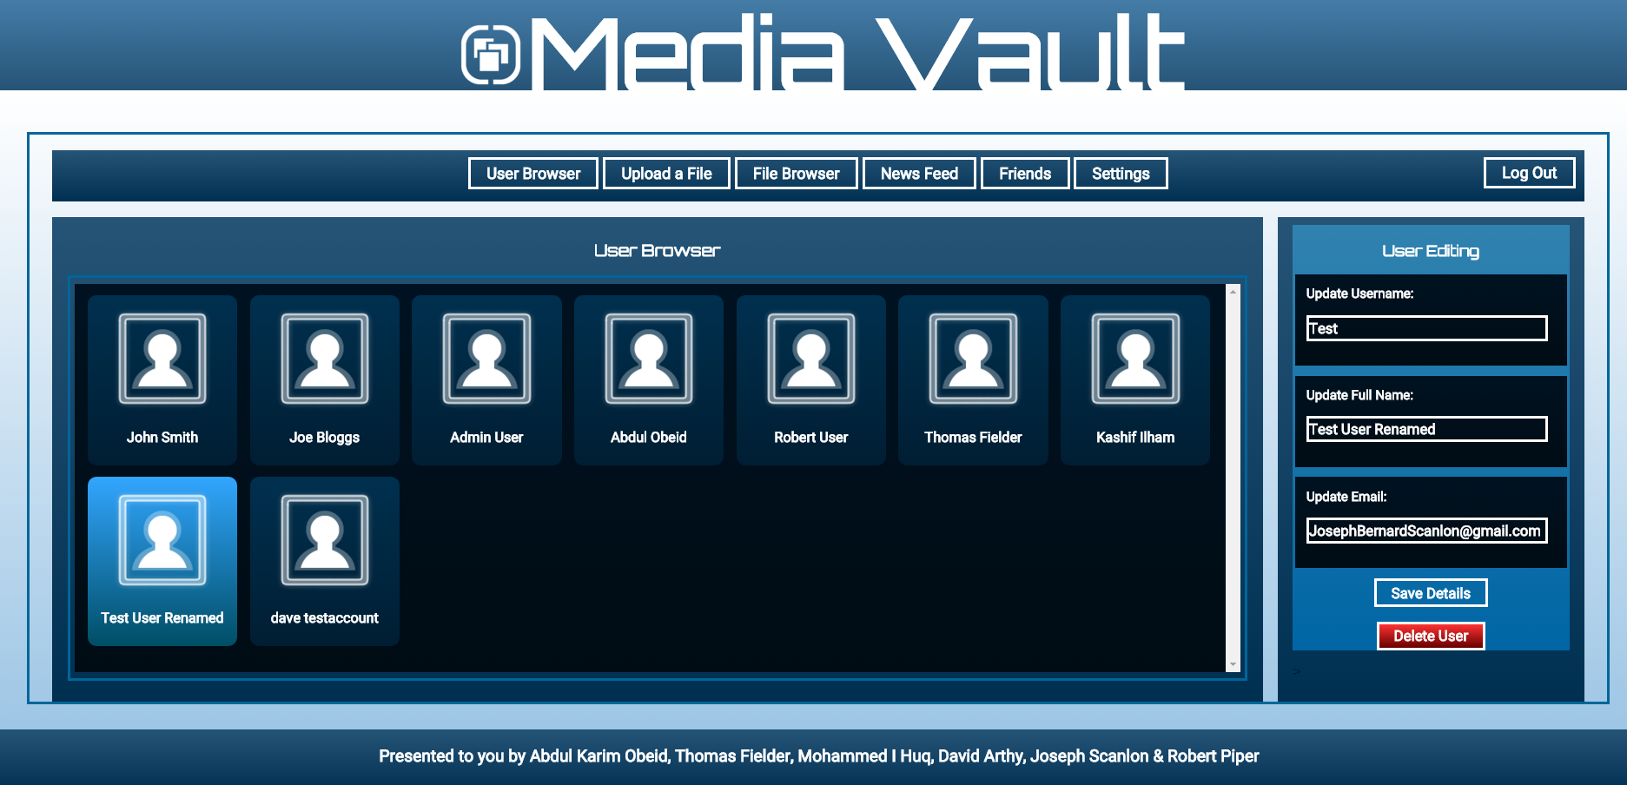
Deleting Test User (Testing Admin User Deletion)

Slide 6
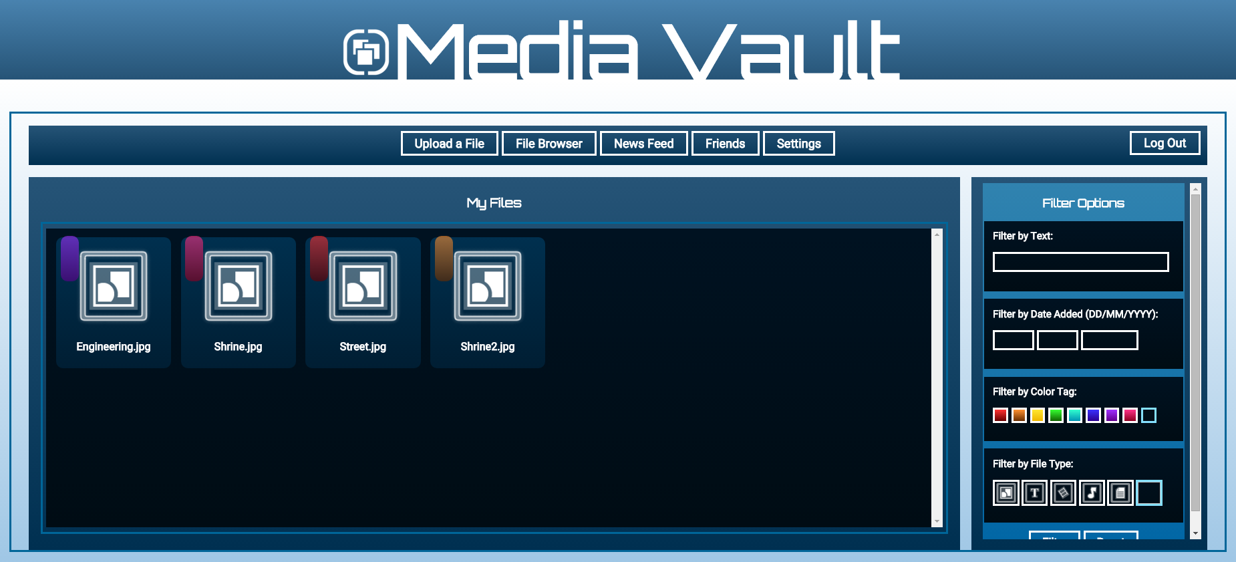
Showing Test User Files (For testing cascading deletion)

Slide 7
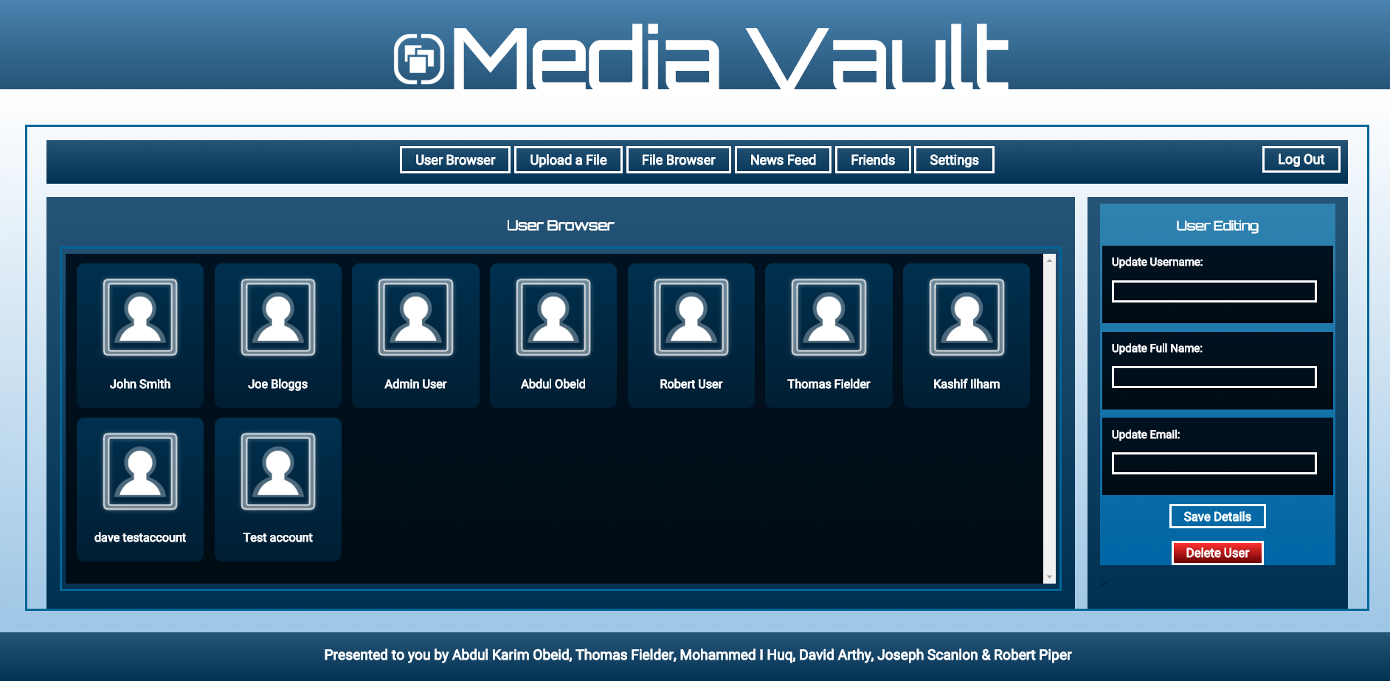
Test User Deleted (Success!)

Slide 8
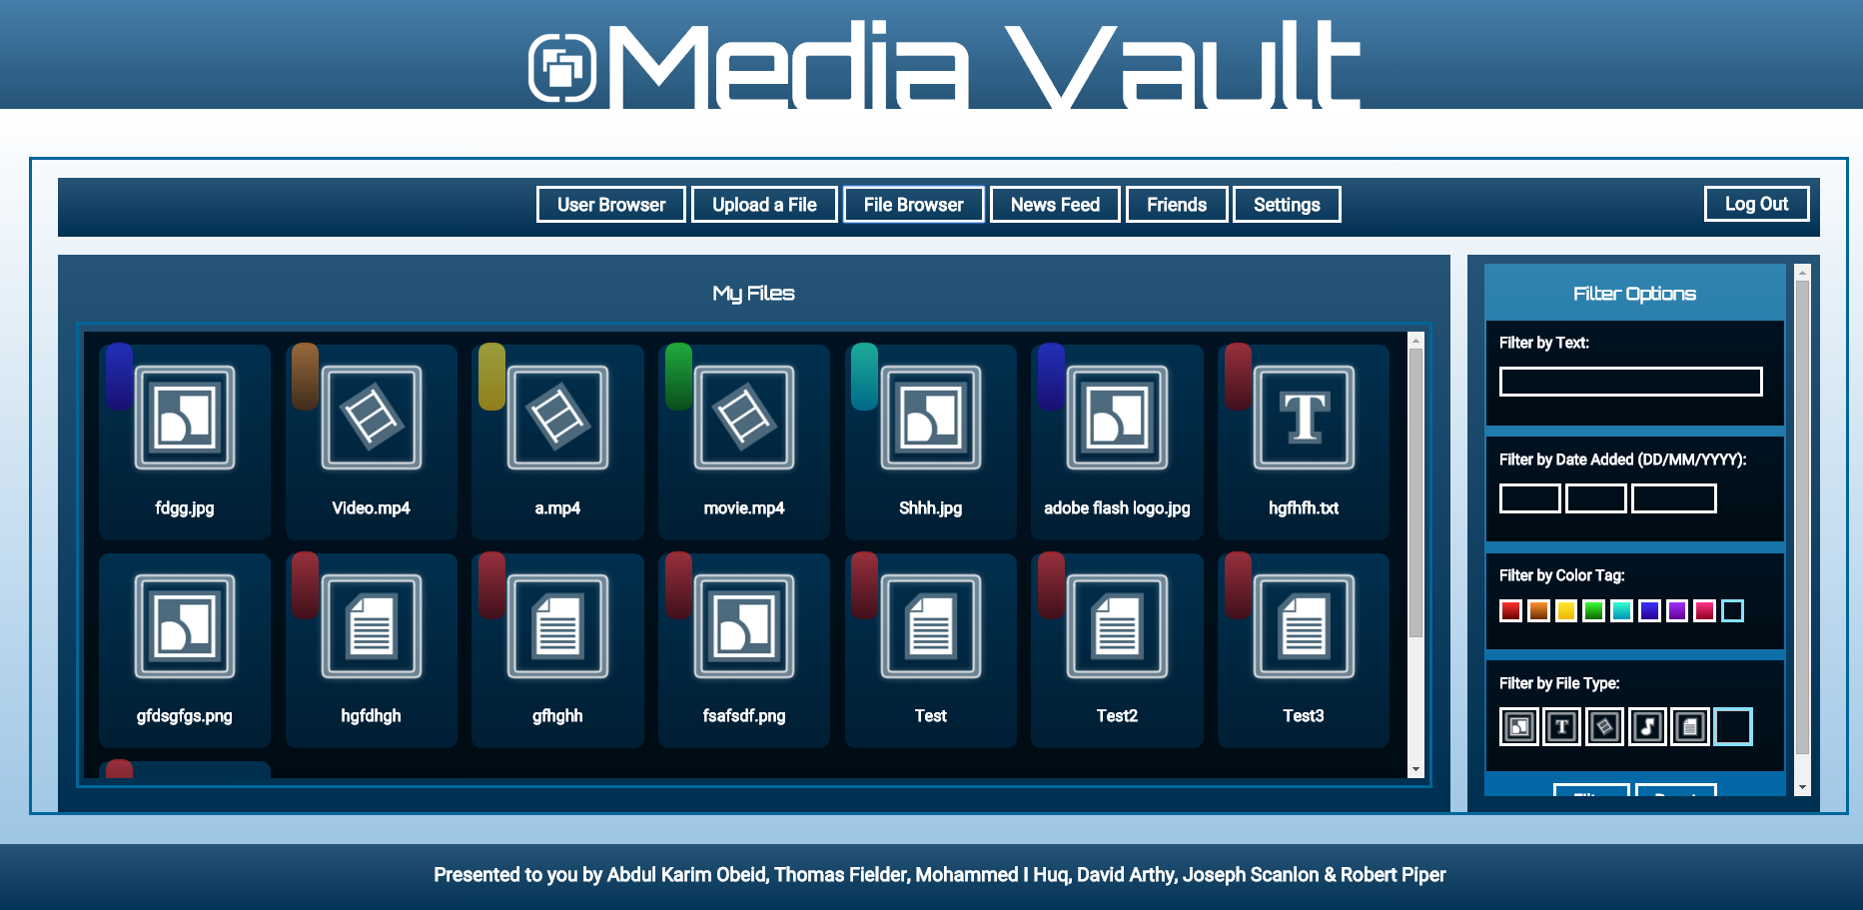
Test User Files Deleted (Success!)

